Slide 1
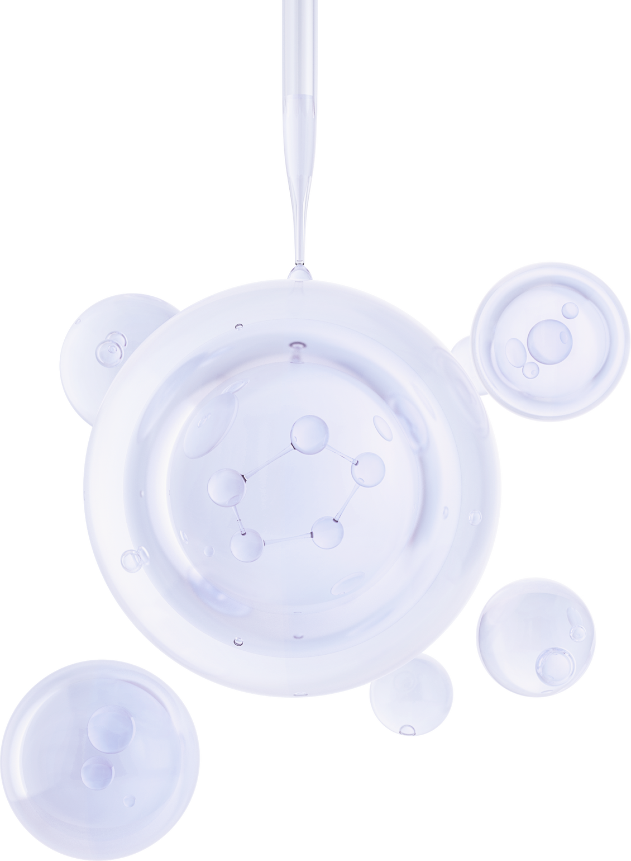


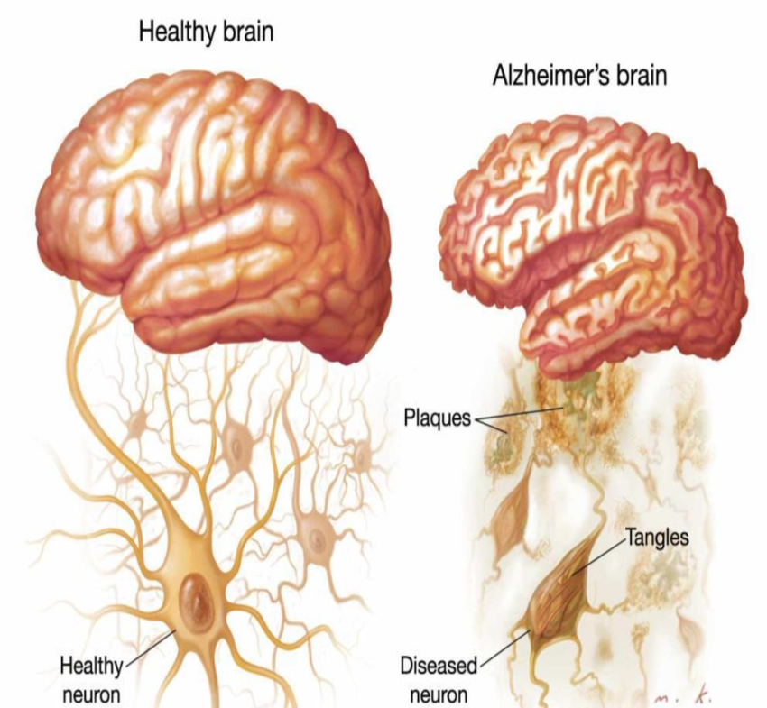
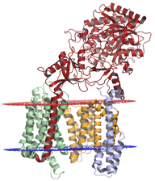
DATA SCIENCE COMPETITION
ALZHEIMER’S BIOACITVITY
PREDICTION
Gamma Secretase complex protein
Presented by
Nanditha JK
JULY 2024

Slide 2
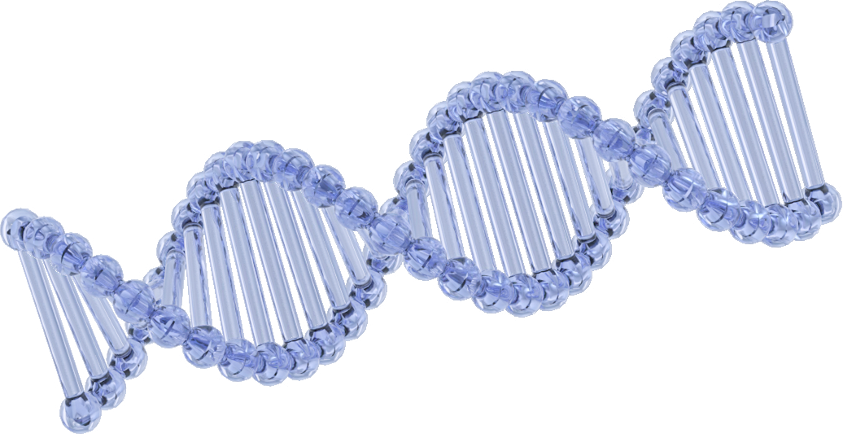
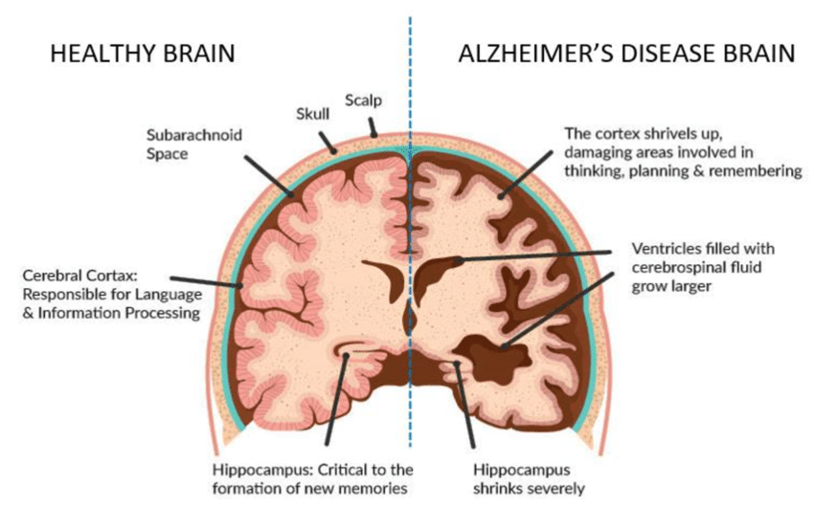
TABLE OF CONTENTS
01. Problem Statement
02. Objectives and Goals
03. Data Pre-processing
04. EDA
06. Model Building and Comparision
07. Deployment
08. Conclusion

Slide 3
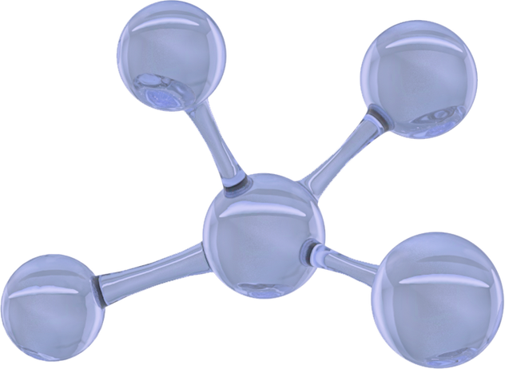
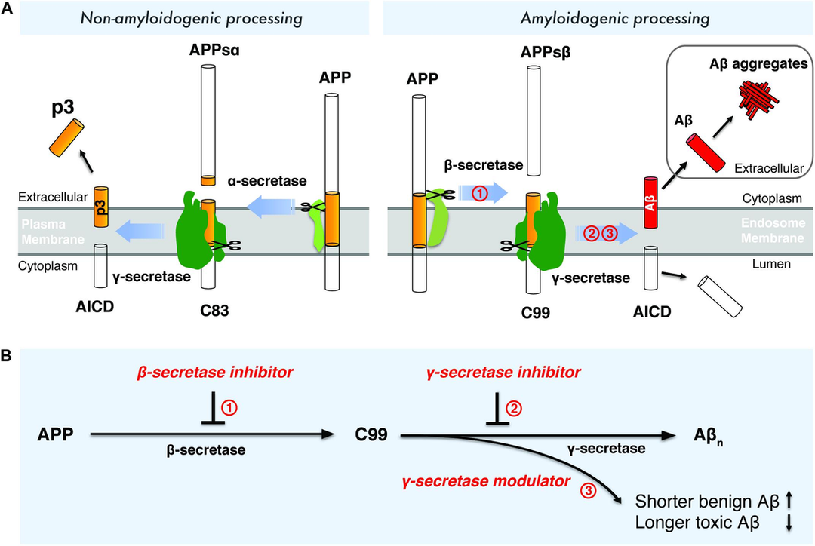
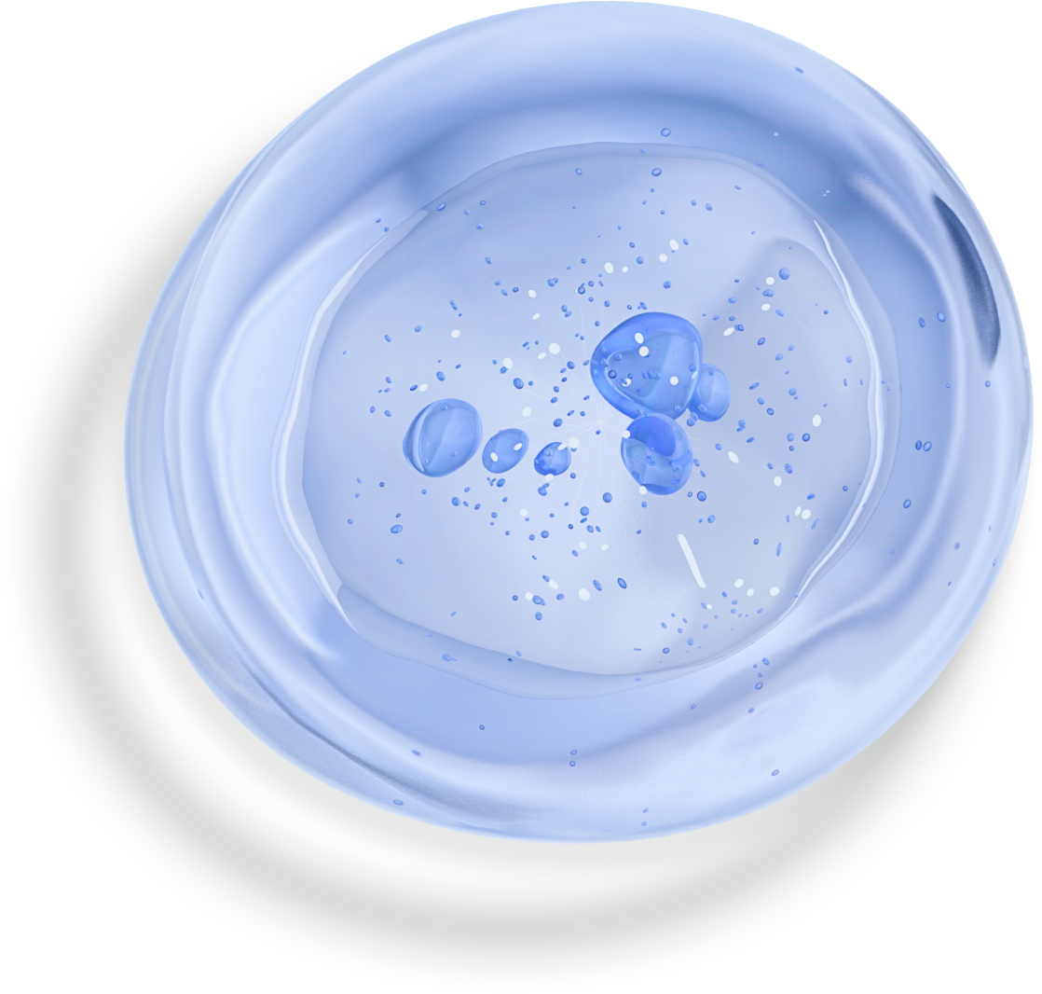
Problem Statement
Alzheimer's disease is a progressive neurological disorder that leads to memory loss, cognitive decline, and ultimately, the inability to carry out daily activities. It is the most common cause of dementia, affecting millions of people worldwide, particularly the elderly.
Despite extensive research, there is currently no cure for Alzheimer's disease, and existing treatments only offer limited symptomatic relief.
Identifying specific proteins involved in the pathogenesis of Alzheimer's disease is crucial for developing targeted therapies.
Gamma-secretase, for instance, is a complex protein that plays a key role in the formation of amyloid-beta plaques, a hallmark of Alzheimer's pathology.
Traditional drug discovery methods are time-consuming and costly, often taking over a decade and billions of dollars to bring a new drug to market.
Computational drug discovery leverages advanced algorithms, machine learning models, and vast biological databases to predict the bioactivity of compounds efficiently.These methods can rapidly screen large libraries of compounds, identify potential drug candidates, and prioritize them for experimental validation.

Slide 4


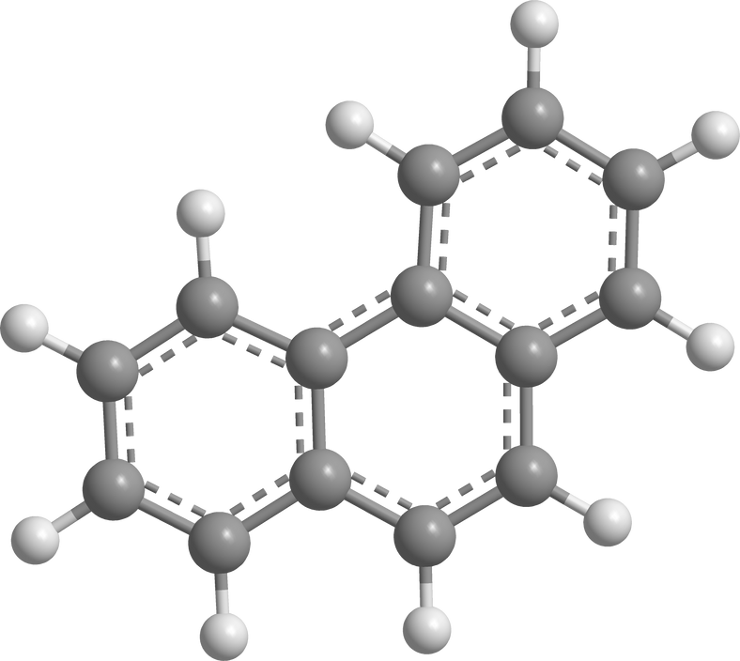
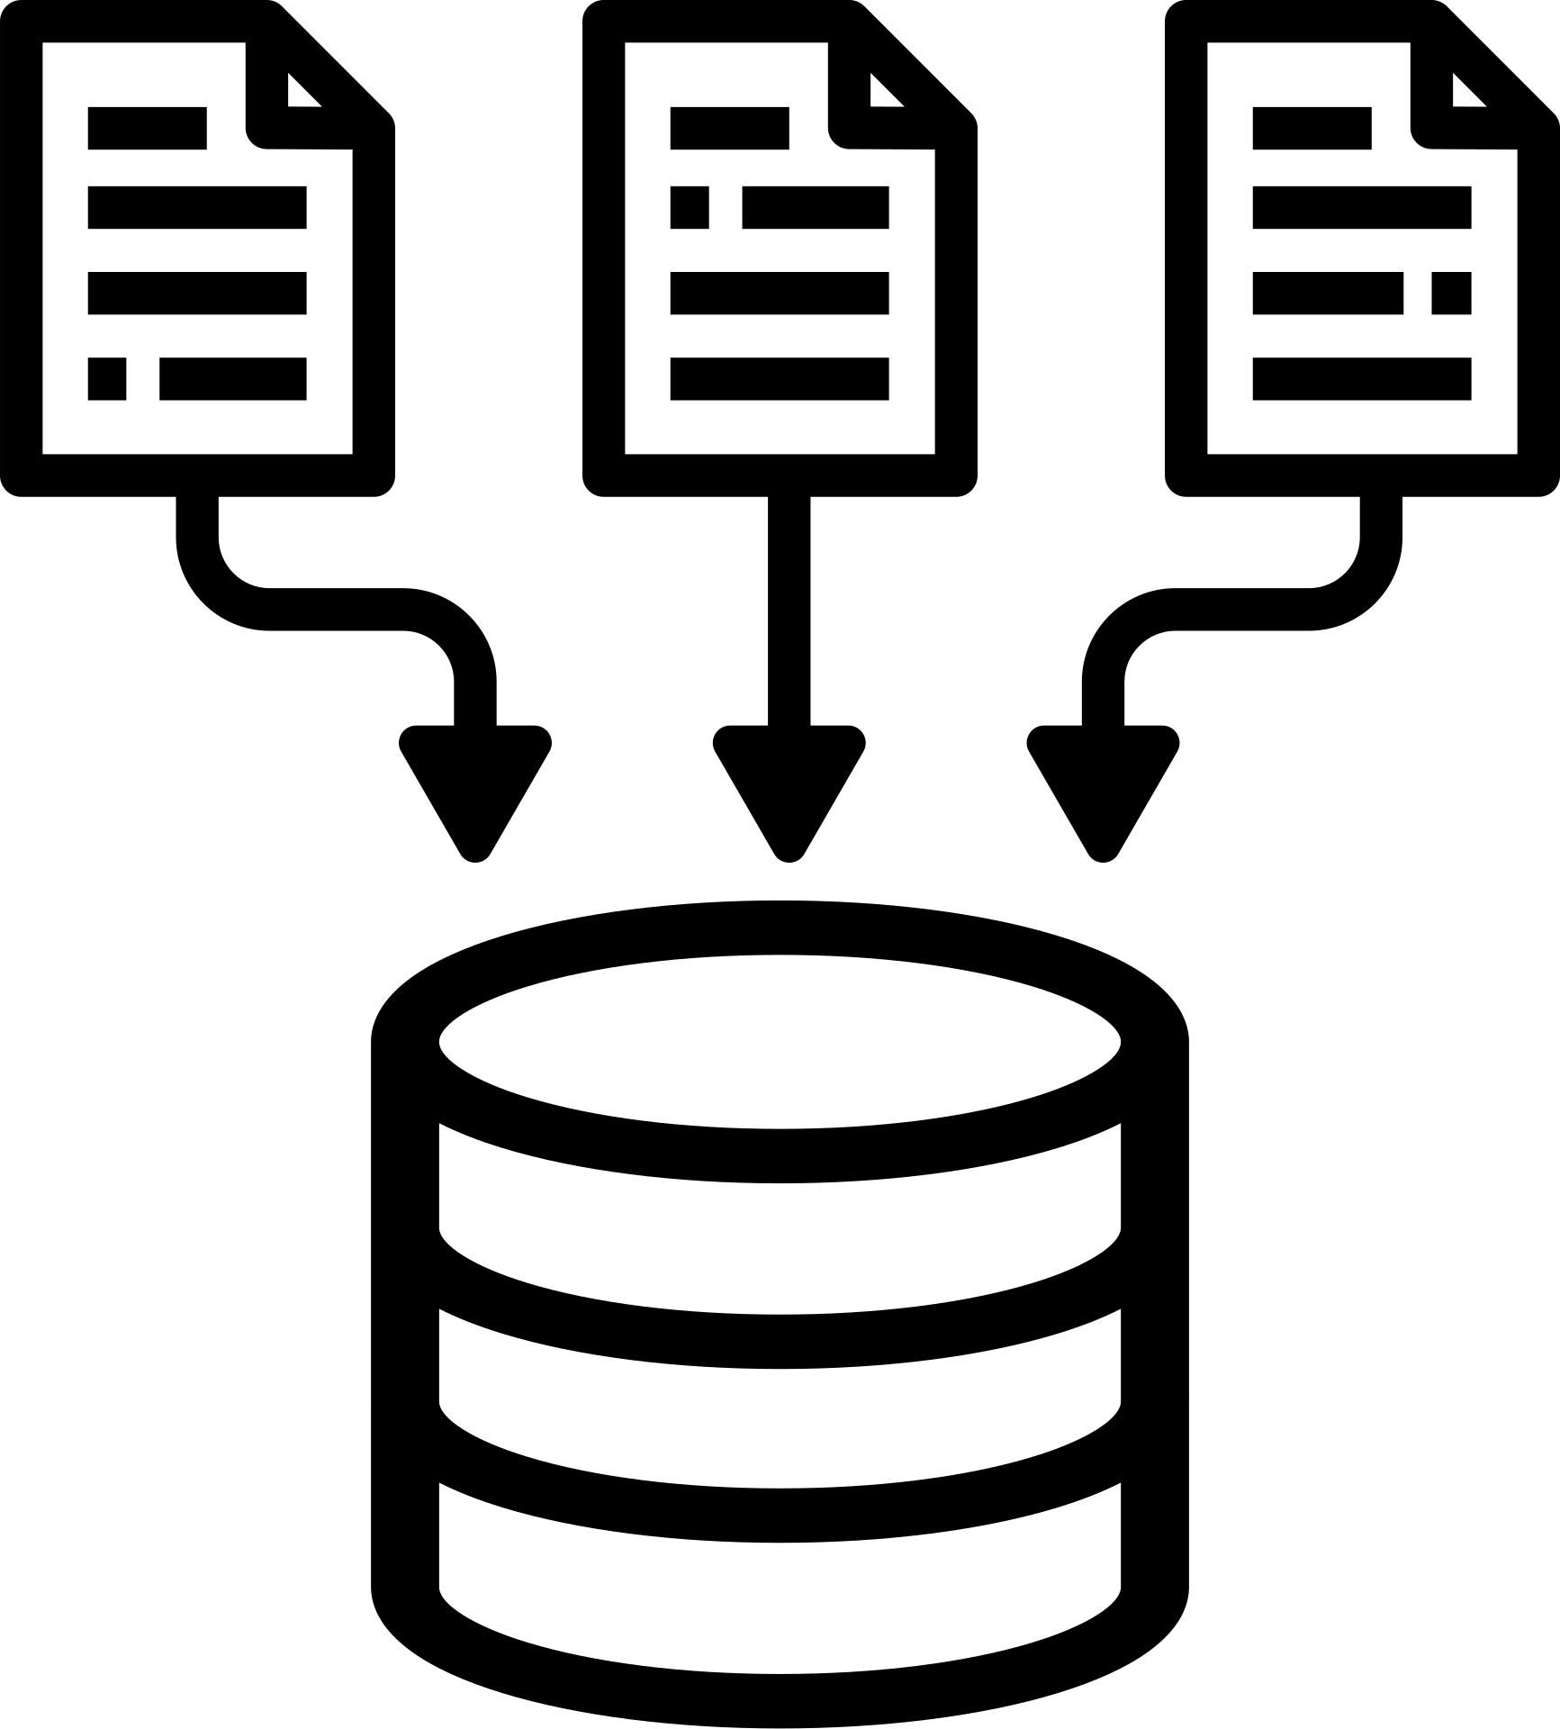


Data Pre-processing
ChEMBL Database
Feature Engineering
Lipinski Descriptor
Final Dataset for model building
For Alzheimer’s diesease there 6 target proteins in our body
Calculationg Bioactivity class
Based on standard value
Active(IC50<1k)
Inactive(IC50>10k)
Intermediate(IC50>1k<10k)
Molecular Weight (MolWt)
LogP (Partition Coefficient)
Number of Hydrogen Bond Donors (NumHDonors)
Number of Hydrogen Bond Acceptors (NumHAcceptors)
Data Extraction
Data Pre-processing
Encoding using Fingerprint Descriptors
3477 rows and 168 columns
Step
01
Step
02
Step
03
Step
04
Step
05
Step
06
Step
07
Gamma secreatse
Selection of bioactivity
features
Target Variable
Selection of one specific protein and extracting the bioactivty of the protein.
Here the protein is complex protein
3537 rows and 46 columns
Converting IC50 to pIC50
pIC50 = -log10(IC50)
pIC50 is target variable
pIC50>6 is active
Canonical Smiles
Standard value
Bioactivity class
Chembl_molecule_id
standard value of bioactivity is IC50
Example - Canonical smile of Avagacestat :NC(=O)C(N(S(=O)(=O)c1ccc(cc1)Cl)Cc1ccc(cc1F)c1nocn1)CCC(F)(F)F
Avagacestat is an oral gamma-secretase inhibitor designed for the selective inhibition of A-beta generation relative to Notch substrates in the treatment of Alzheimer's Disease

Slide 5
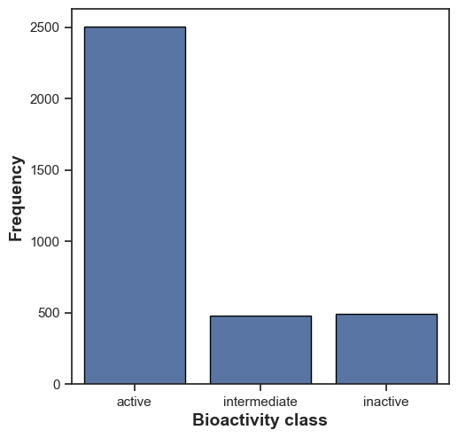
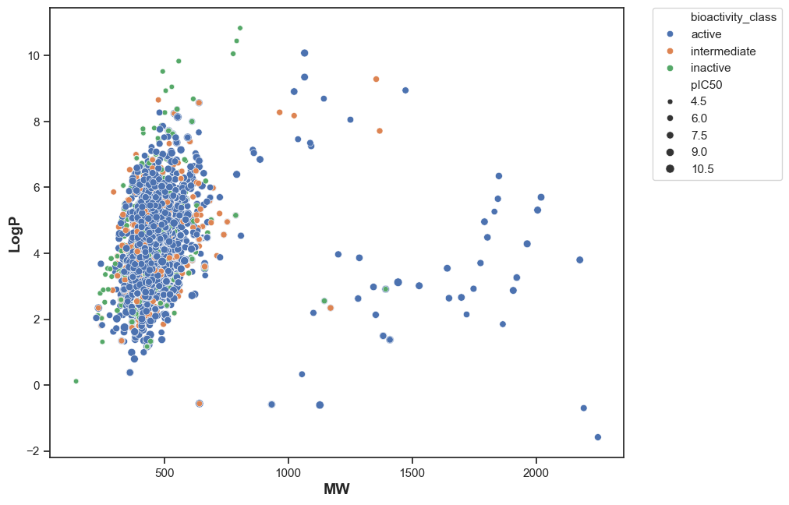
Exploratory Data Analysis
Gammasecreatse data contains more bioactive molecules compared to inactive and intermediate.
The scatter plot explains the ditribution of molecules with their classes and pIC50 values, where active with pIC50 value 7.5 to 9.0 are more in the target protein
Also used Mann-Whitney U Test for Statistical Analysis

Slide 6
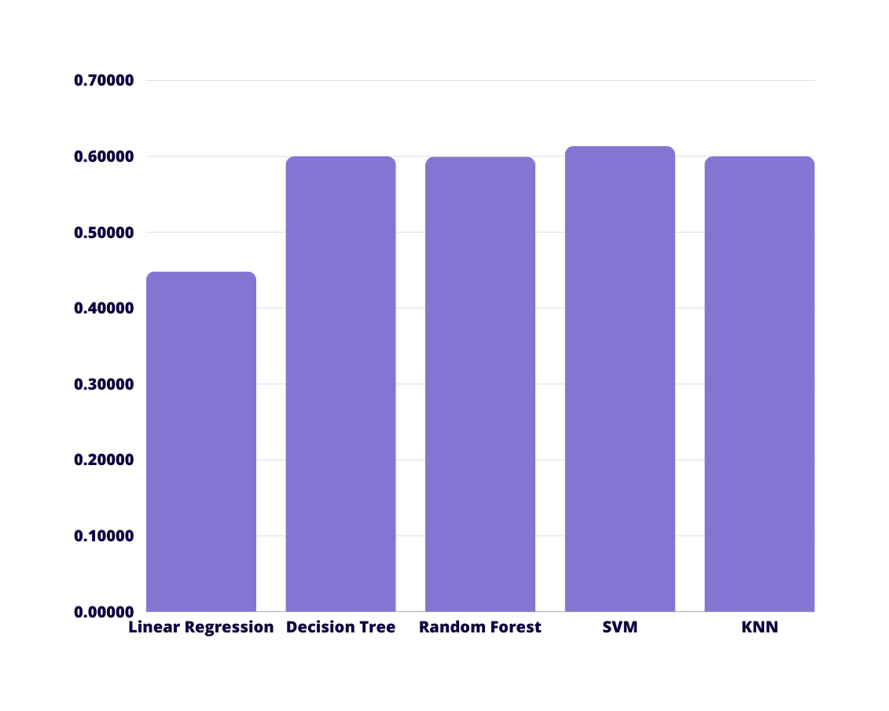
Model Comparision
By comparing with all the Algorithm SVM (Linear)​ is giving you the higest accuracy

Slide 7
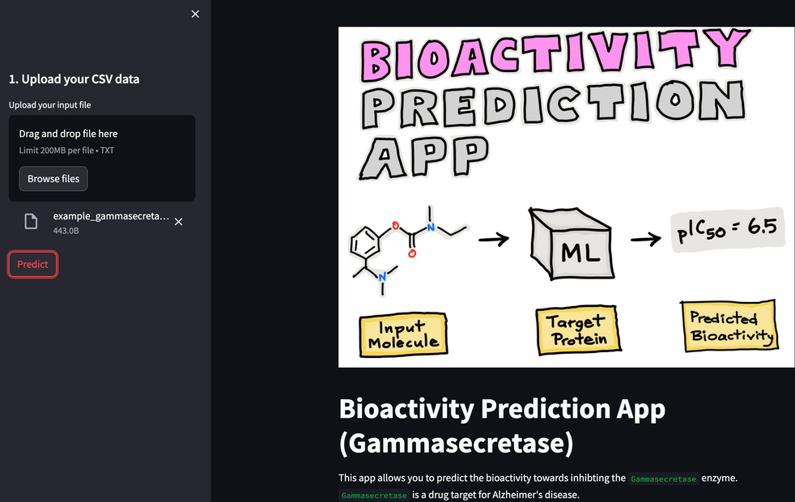
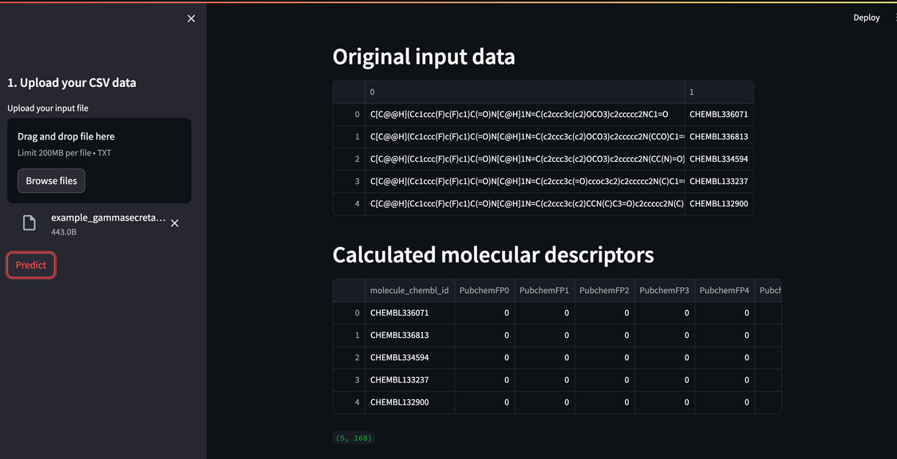
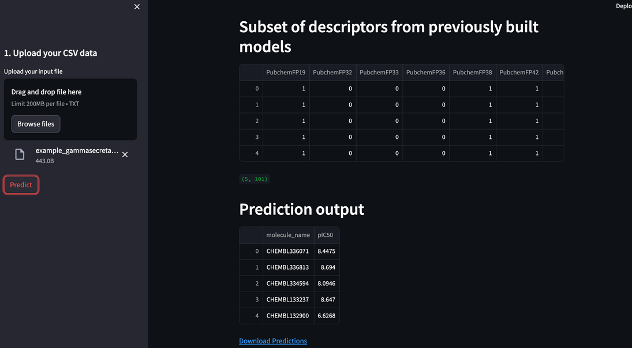
Deployment

Slide 8
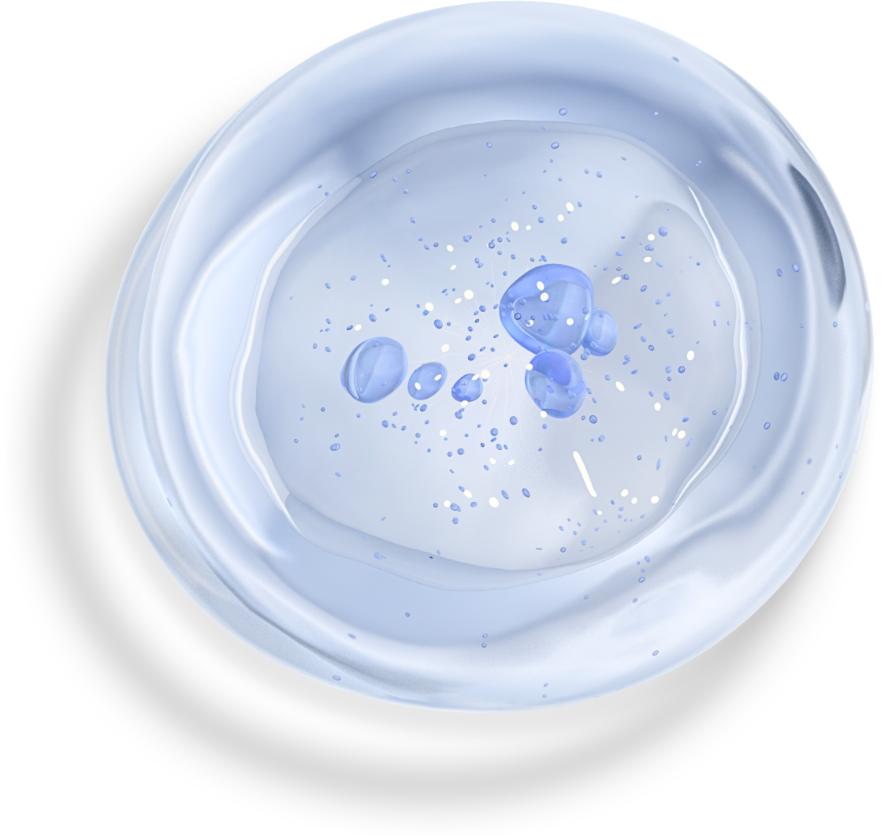
Conclusions
Enhanced Drug Discovery: The developed predictive models for gamma-secretase activity offer valuable insights into the efficacy of compounds, aiding in the identification and prioritization of potential Alzheimer's disease treatments.
Integration with Bioinformatics Platforms: The methodology and models can be integrated into bioinformatics tools and drug discovery platforms, providing real-time predictions and accelerating the screening of new compounds.
Scalable Deployment: The models can be deployed in a cloud-based environment or integrated into existing drug discovery systems, allowing for scalable and accessible analysis of compounds.
User-Friendly Interface: Implementing a user interface for researchers to input and analyze new compounds will facilitate practical application and enhance decision-making in drug development.

Slide 9
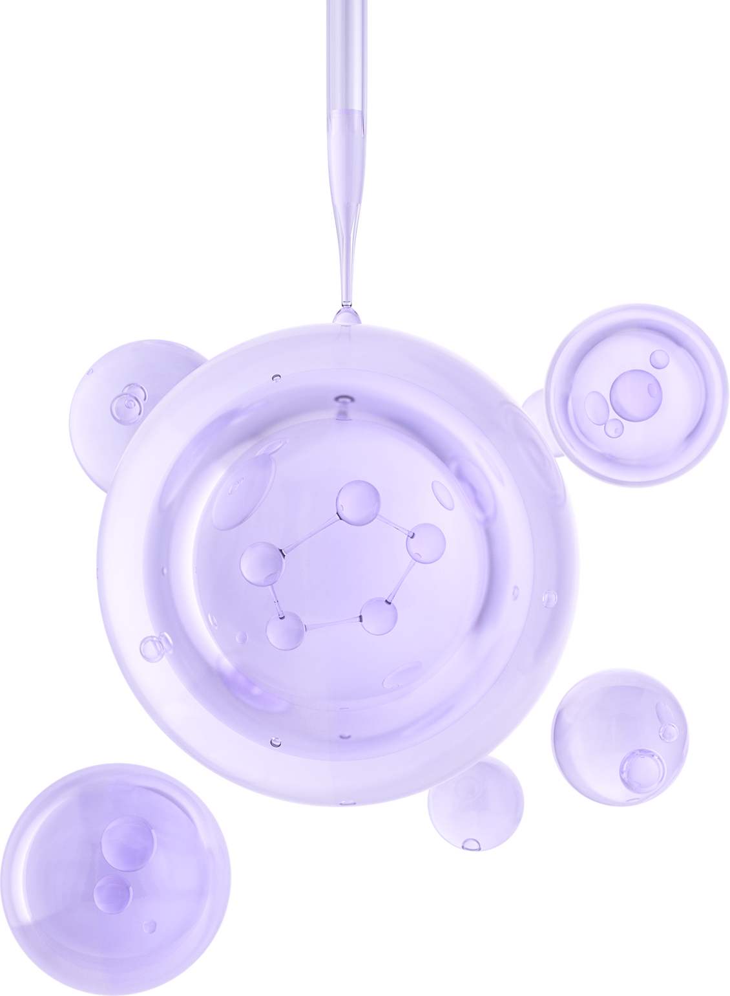





THANK YOU
Nanditha JK
https://www.linkedin.com/in/nanditha-j-k-268880246/
+91 8105272513
nandithajkj1999@gmail.com
Bengaluru

